Slide 1
Doing Research on Your Teaching
Resources & Support at Northwestern
Denise Drane PhD MPH
Senior Associate Director for Research and Innovation
Searle Center for Advancing Learning and Teaching
June 6th 2025

Slide 2

Overview
Why begin?
Gathering Ideas
Resources to Lighten Your Load
Navigating the IRB
Places to Publish
Finding Community
Opportunities for Learning

Slide 3
When you think about doing research on your teaching does the thought energize you, or does it deplete your energy?

Slide 4
Where are you on the scale?
0
Even just thinking about this exhausts me
10
This idea fills me with energy. I can’t wait to get started

Slide 5
Why do research on your teaching?
What are the benefits for you?

Slide 6
How SoTL Can Support Instructor Vitality
Purpose & Meaning | Reconnects with your personal mission
Intellectual Engagement | Turns teaching into inquiry
Growth & Recognition | Leads to publishing and collaboration
Community & Connection | Builds collegial dialogue
Autonomy | Encourages pedagogical ownership
Renewal | Introduces fresh practices

Slide 7
Benefits of SOTL for Participants
nurtured teachers’ inquiry mindset
enhanced collaborative inquiry
facilitated the implementation of changes in praxis
enabled their emancipation in the SoTL community.
Yang (2025) https://doi.org/10.1016/j.system.2025.103658

Slide 8
Examples of the Range of Projects
Describing
An innovation
Students’ reaction to an innovation
How students understand something
Misconceptions that students hold
Measuring
The effectiveness of an innovation or tool
Students’ experience in the classroom
Outcomes of a program
Student Development
Reflecting
On your experience as an instructor
Your students experiences

Slide 9
Getting Started
What are you curious about?
Where do you or your students get stuck?
What is working really well?
What are areas that are particularly challenging for you as an instructor?
What ideas and innovations have you been experimenting with?

Slide 10

Sources of Data
Existing Data from your class
  Homework
  Assignments
  Exams
  Student projects
  Student reflections
  Course/Program retention data
New data that you will collect
  A survey/tool that you design
  A validated survey/tool you design
  A new assessment that you design for your research project
  An interview, focus group or survey

Slide 11
Northwestern Research Resources to Lighten Your Load

Slide 12
Northwestern Library Resources
Subject Librarians by language
Scholarly Research Services

Slide 13
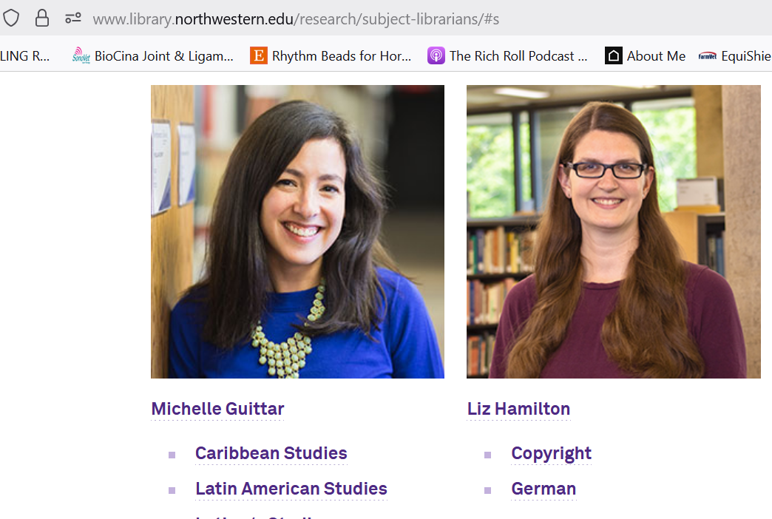
Subject Librarians

Slide 14
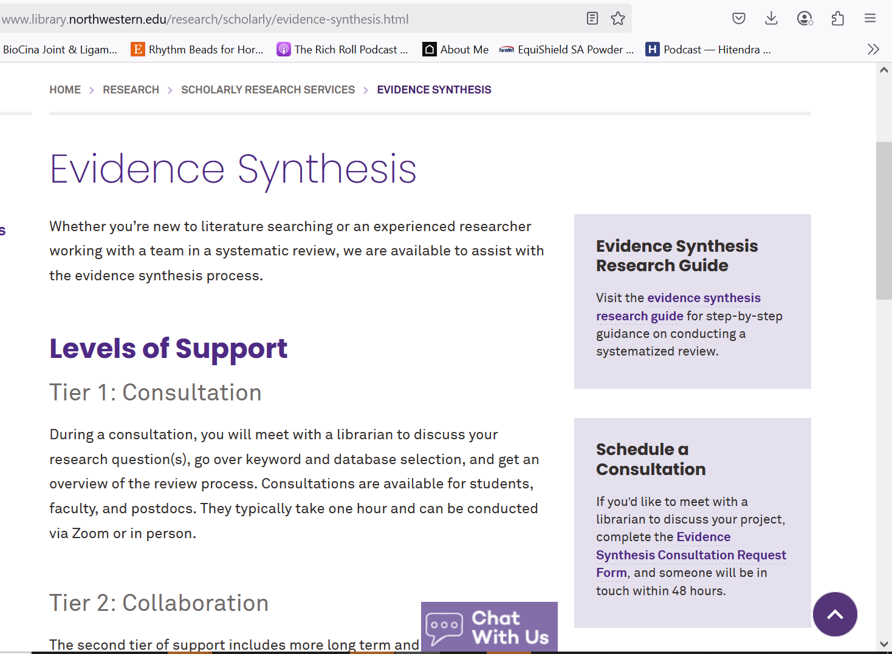
Scholarly Research Services

Slide 15
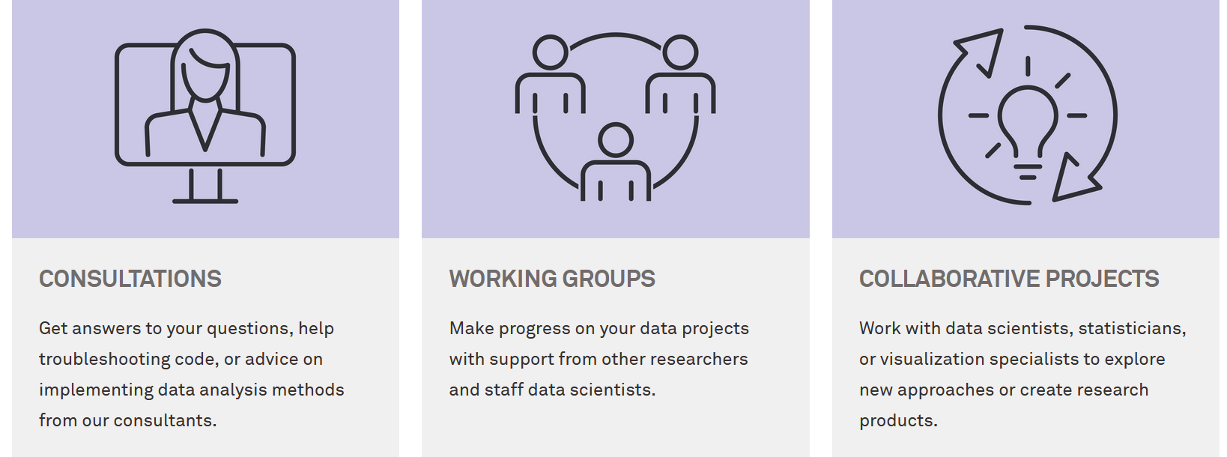
NU Research Computing and Data Services
Helps researchers apply methods from statistics, data science, computer science, and other fields to analyze and visualize data in their research domain
https://www.it.northwestern.edu/departments/it-services-support/research/data-science-statistics-visualization/

Slide 16
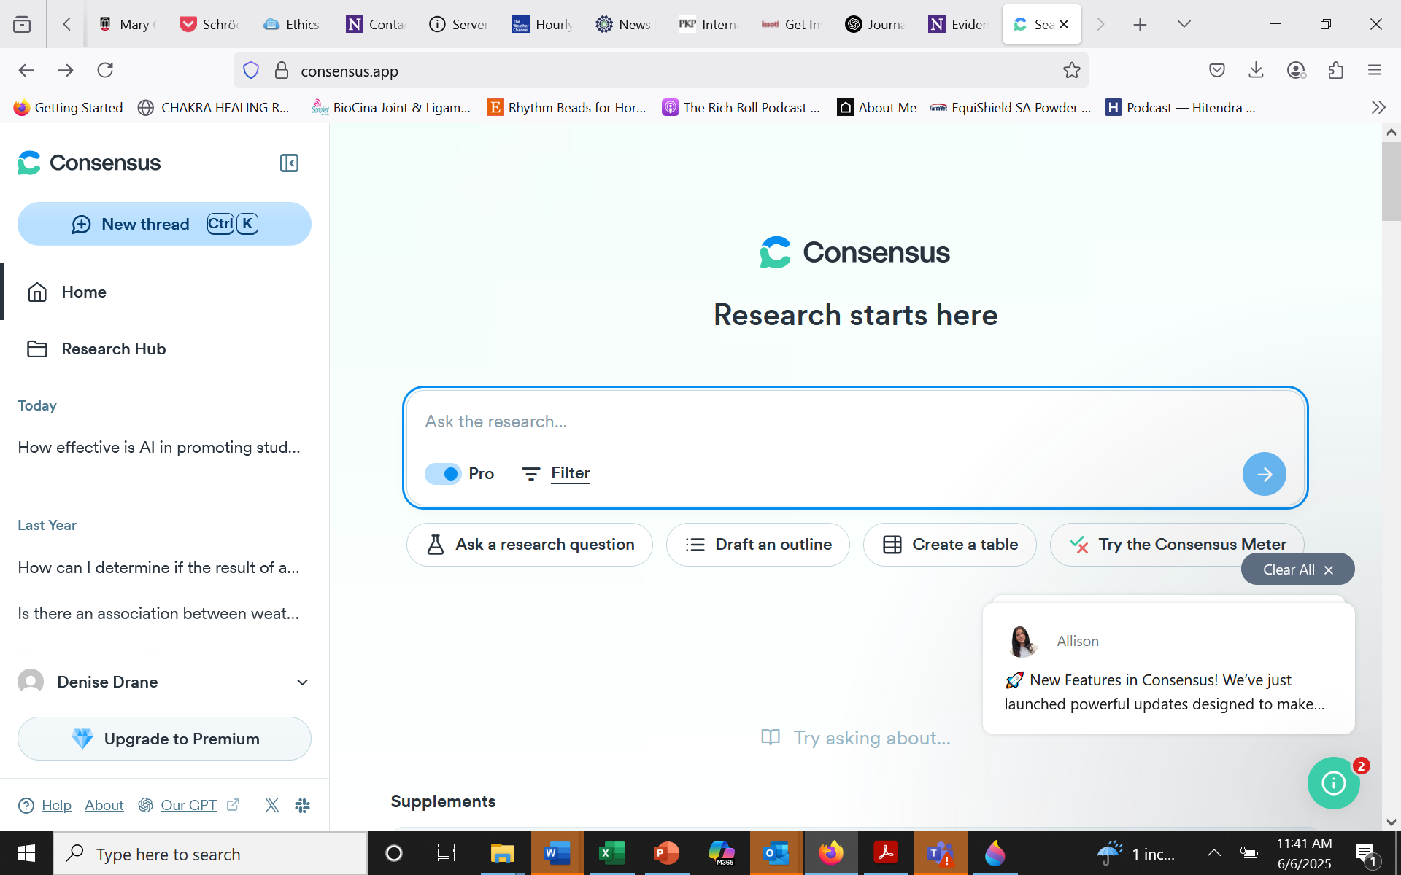
AI Based Tools for Literature Searching

Slide 17
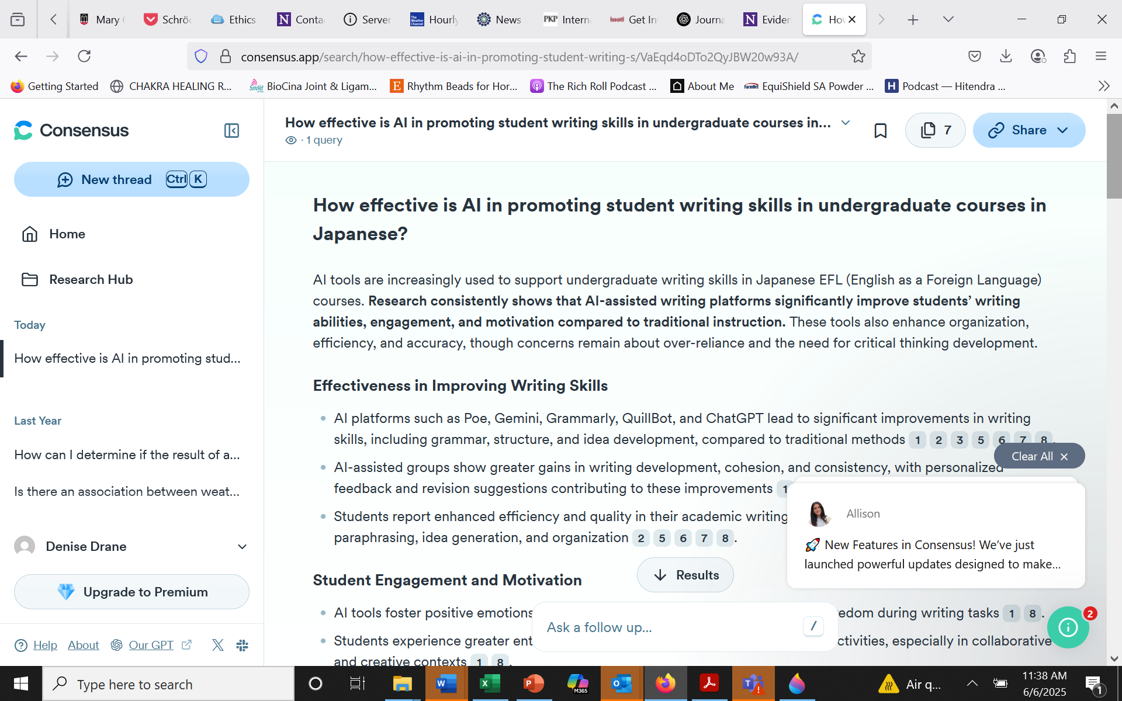

Slide 18
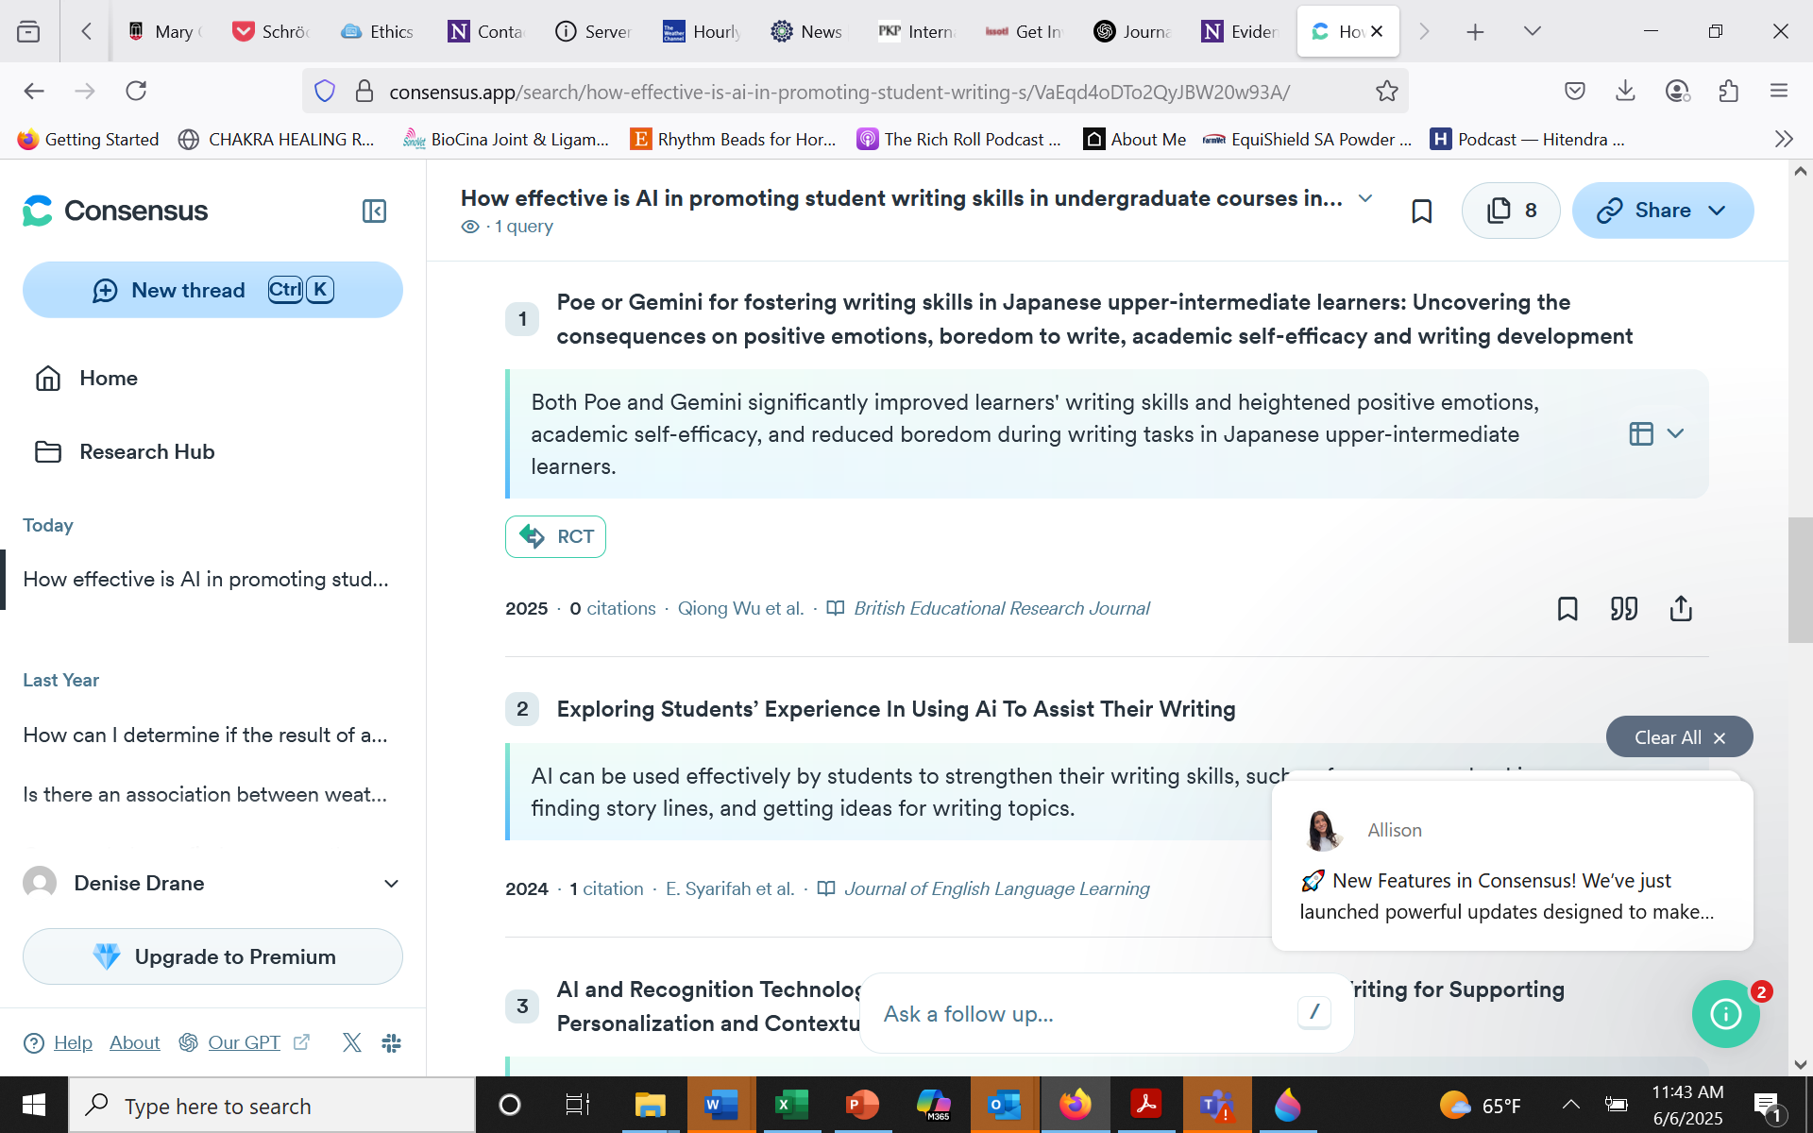

Slide 19

Institutional Review Board
Don’t let this be a barrier

Slide 20

Do you need IRB approval to do research on your teaching?

Slide 21

It depends

Slide 22
Step 1
Is this human subjects research?

Slide 23
Is this human subjects research?
“Only activities that meet the definition of research involving human subjects as defined in the DHHS, FDA or other applicable regulations require IRB review”

Slide 24
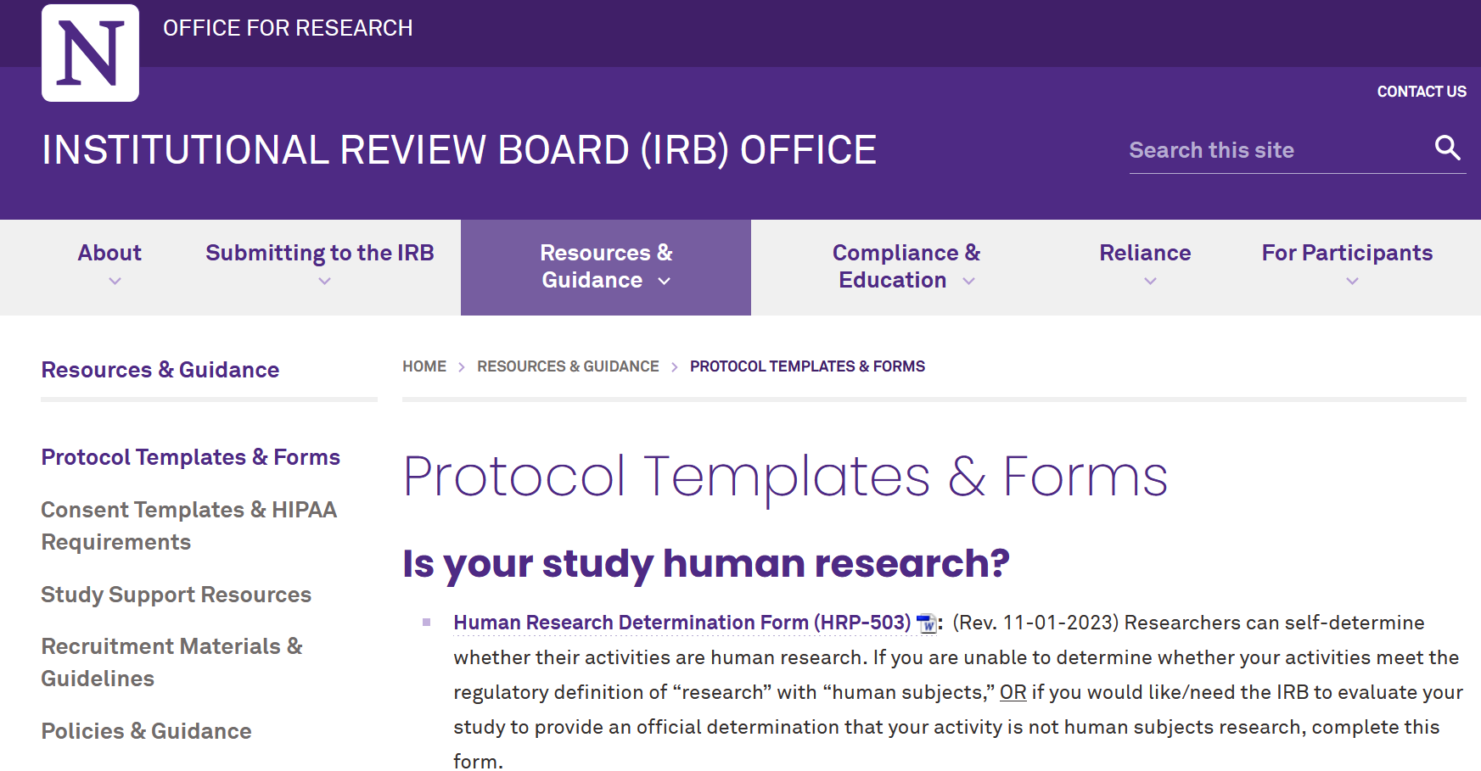
https://irb.northwestern.edu/resources-guidance/protocol-templates-forms/

Slide 25
Part A: Is this research?

Slide 26
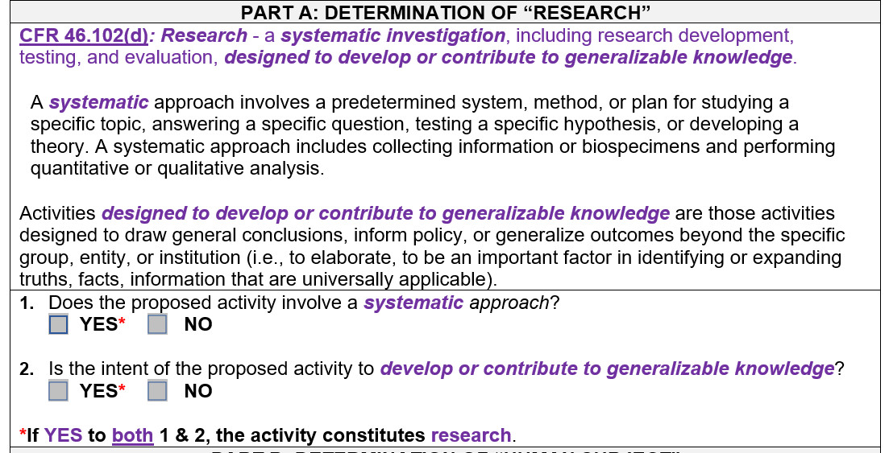

Slide 27
Part B: Is this human subjects?

Slide 28
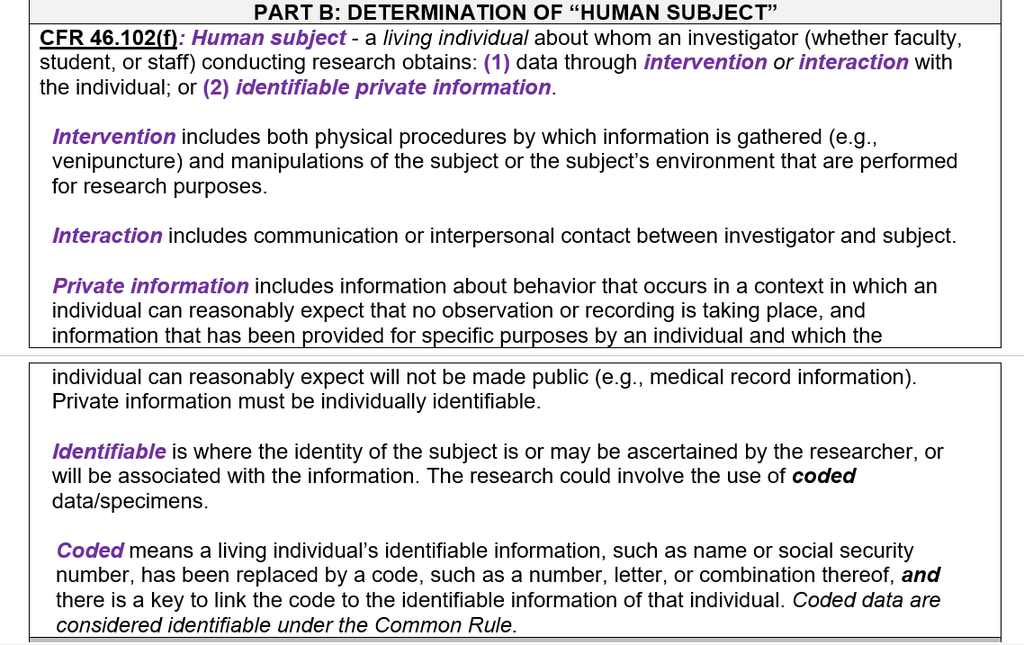

Slide 29
If the IRB or you determine that your research is not human subjects research, you do not have to do anything else.
If your research is human subjects research, you need to decide if your study requires oversight from the IRB or if it’s exempt from oversight of the IRB (exempt review).
This requires an application to the IRB.

Slide 30
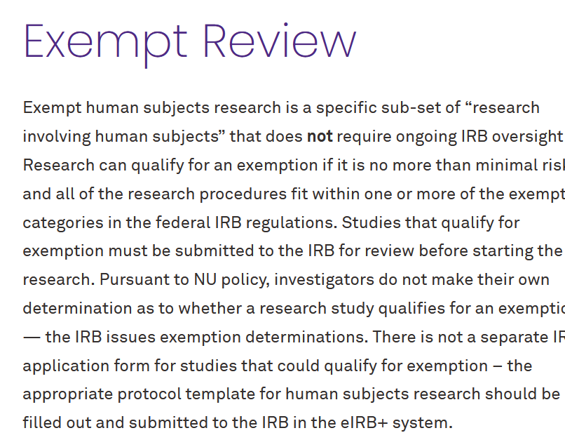
https://irb.northwestern.edu/submitting-to-the-irb/types-of-reviews/exempt-review.html#exempt1

Slide 31
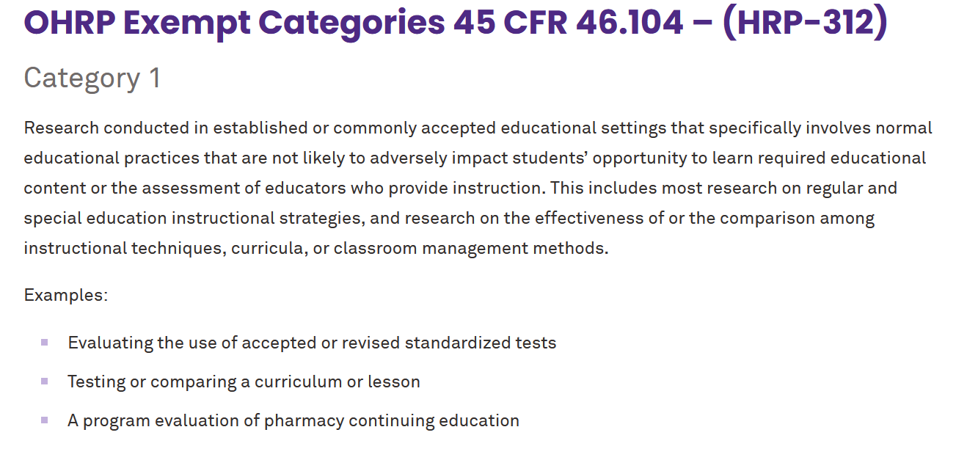

Slide 32
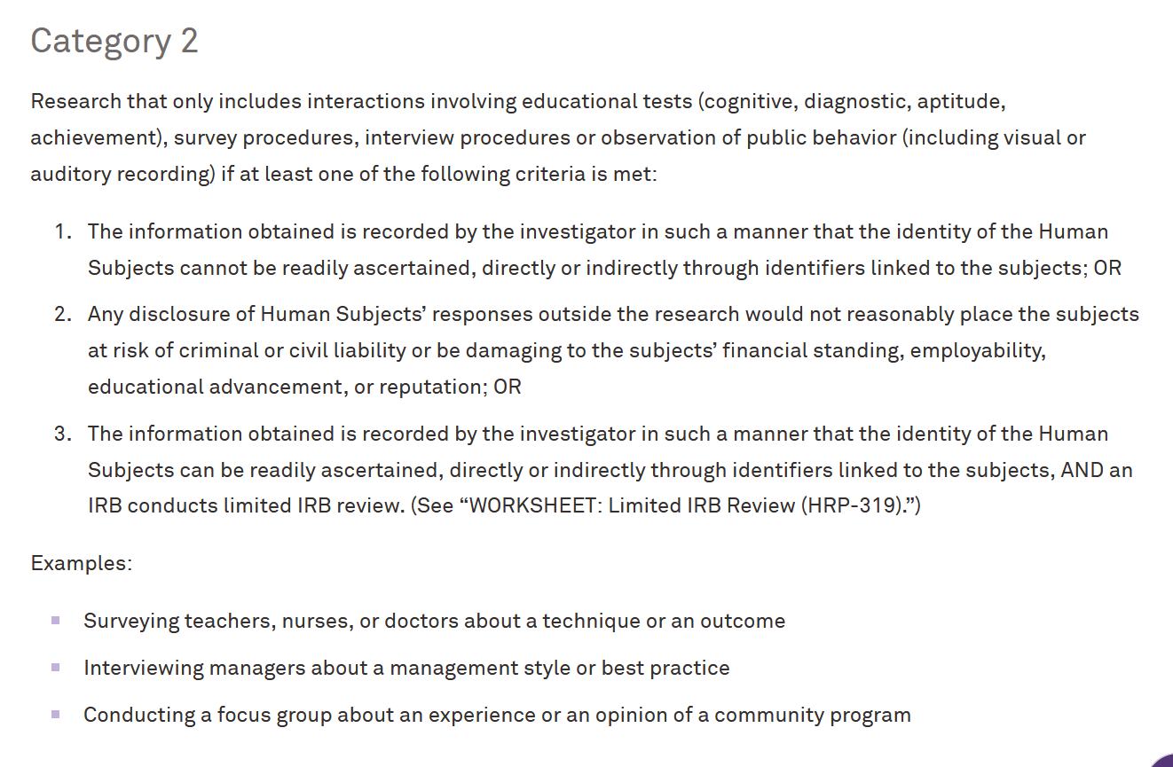

Slide 33
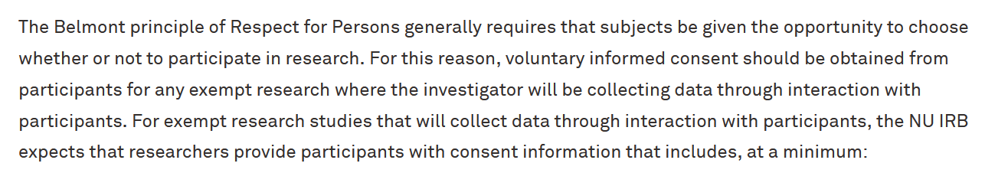
Studies that are IRB Exempt Require Consent

Slide 34

Err on the side of Caution
The IRB Office encourages investigators to err on the side of caution in determining whether to submit a Human Research Determination request because the Office will not review already conducted research if the investigator later learns that IRB review was required.

Slide 35
Err on the side of Caution
The IRB Office encourages investigators to err on the side of caution in determining whether to submit a Human Research Determination request because the Office will not review already conducted research if the investigator later learns that IRB review was required.
Note that some journals require you to have evidence that either your project has IRB approval or that it has been reviewed and designated as “Not Human Subjects Research”. The Northwestern IRB can provide documentation for you for this.

Slide 36
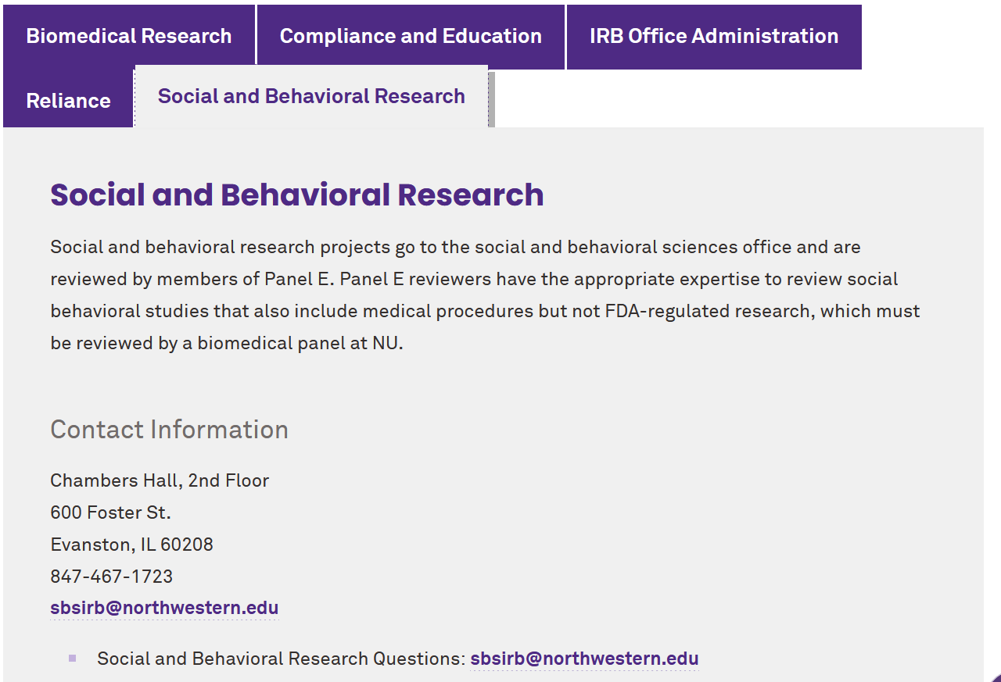
The IRB Team is very helpful!!!

Slide 37
The Searle Center Can Partner with You
Develop research questions
Design your study
Identify data sources
Develop surveys, interview & focus group questions
Suggest approaches for data analysis
Provide feedback on manuscript drafts
Can create learning & writing communities

Slide 38
Funding Opportunities in Weinberg & Northwestern
Hewlett Fund for Curricular Innovation
  https://lrc.northwestern.edu/language-instruction/funding-opportunities/hewlett-fund-for-language-faculty.html
Office of the Provost
  https://www.northwestern.edu/provost/faculty-resources/funding-opportunities/
Alumnae Grants
  https://lrc.northwestern.edu/language-instruction/funding-opportunities/hewlett-fund-for-language-faculty.html

Slide 39

Options for Publishing Your Work

Slide 40

Scholarship of Learning and Teaching Journals

Slide 41
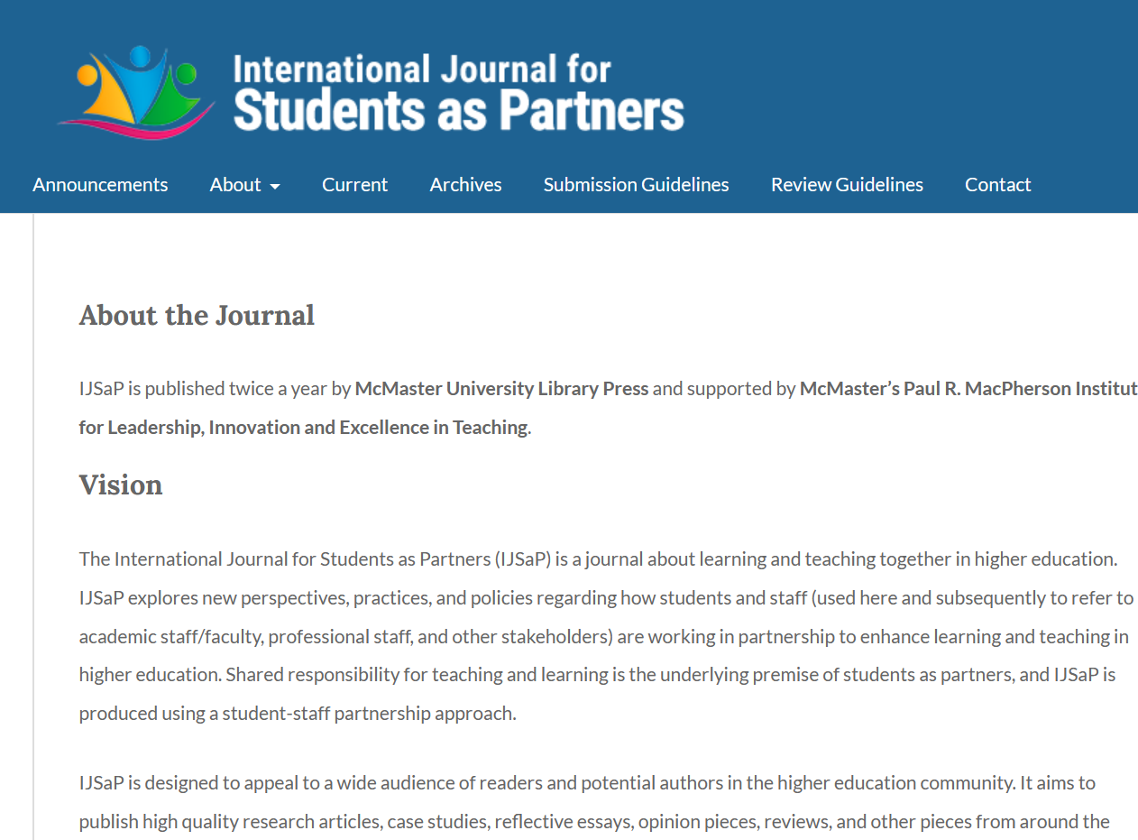
A Journal on Scholarship with Students

Slide 42
Opportunities for Community
&
Professional Development
Professional Societies
Conferences

Slide 43
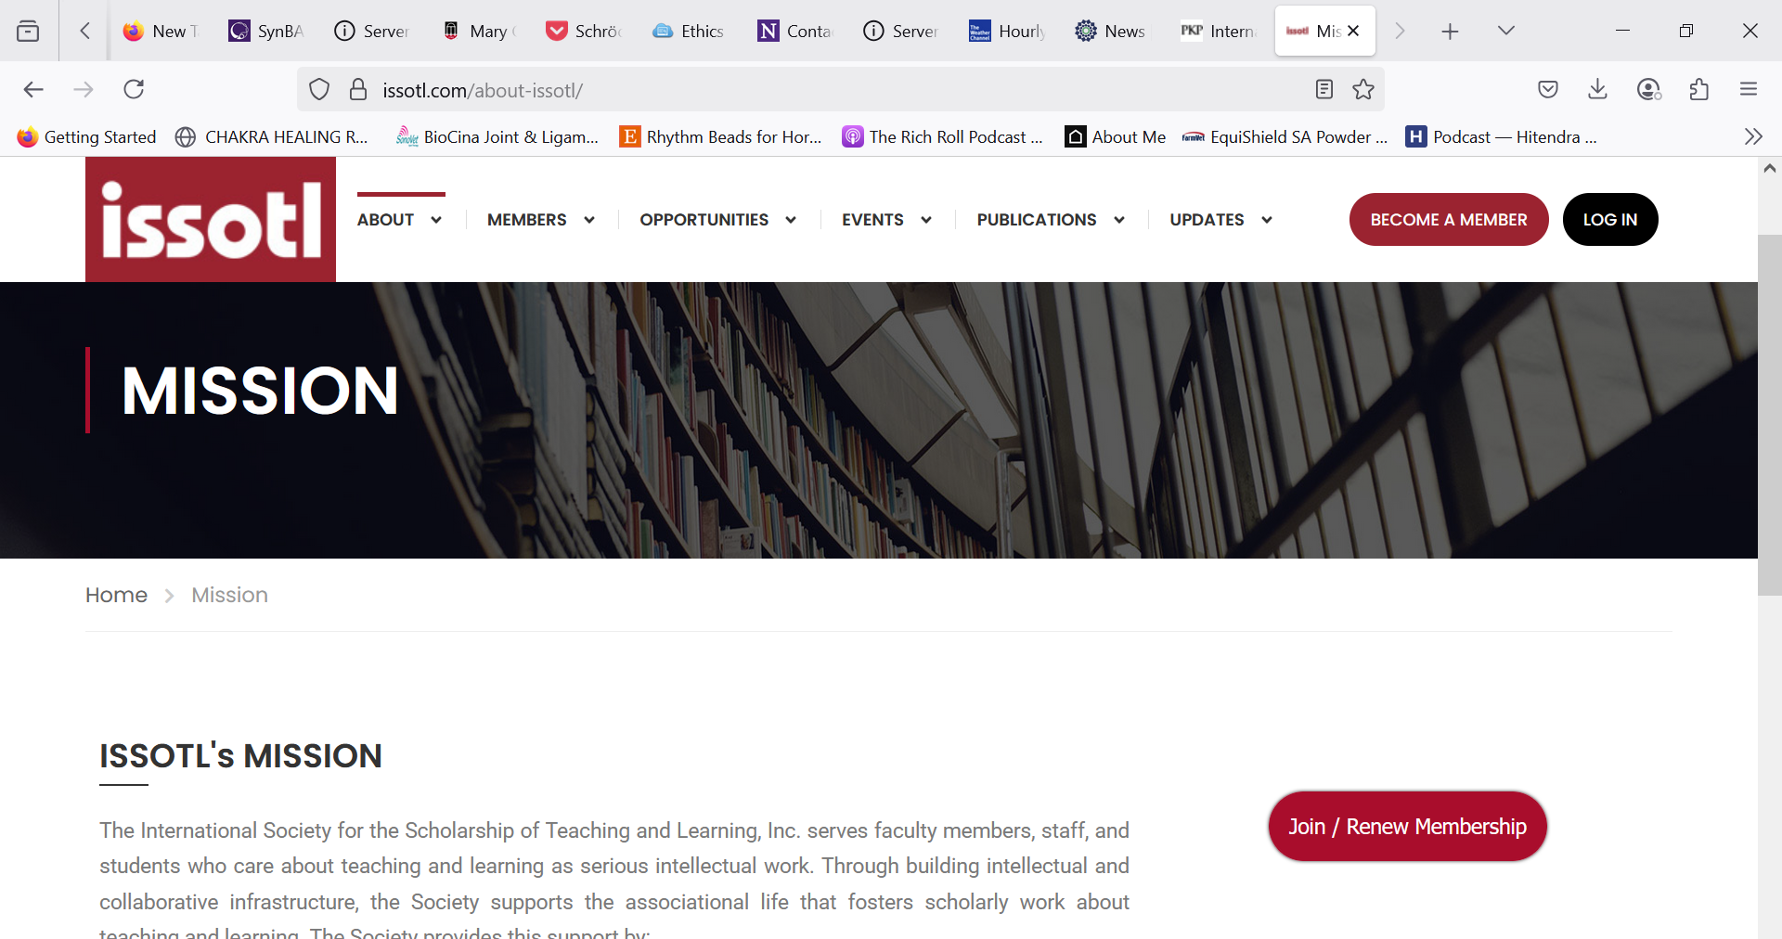

Slide 44
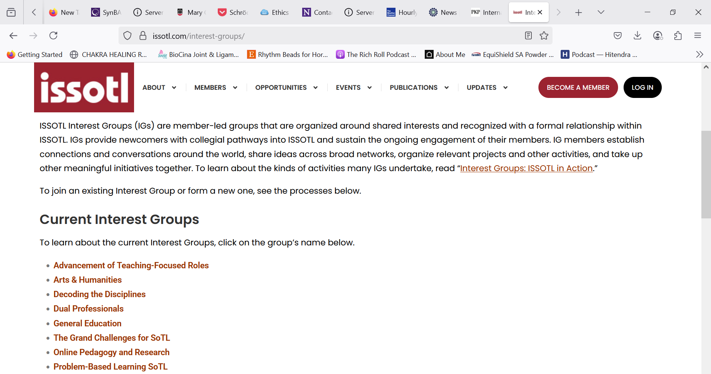

Slide 45


Slide 46
ACTFL
Upcoming Qualitative Research Workshop on July 16th
We are excited to share that Dr. Tracy Quan (UC Boulder) will be presenting an ACTFL Research SIG workshop on qualitative coding in language education on Wednesday July 16th @ 2pm CST: "What happens after collection? Analyzing and reporting qualitative data in language research"
The online workshop is free for all ACTFL members. This is a great opportunity to learn from a fantastic scholar in our field!
The ACTFL webinar on coding qualitative research is only visible to ACTFL members – Members needs to login to the ACTFL portal, and go to My ACTFL > Upcoming Webinars.

Slide 47

https://nflrc.hawaii.edu/events/view/publishing-success/

