Slide 1






Teacher Licensure in
WORLD
LANGUAGES
for Northwestern Students
Rebekah Stathakis
Director, Teacher Preparation Programs
Gaby Langendorf
Manager, Teacher Licensure
Notes:
Rebekah

Slide 2

Agenda:
Introductions & Program History
Need for World Language Educators
Pathways at NU
Requirements
Opportunities for the Future
Questions
Notes:
Rebekah

Slide 3

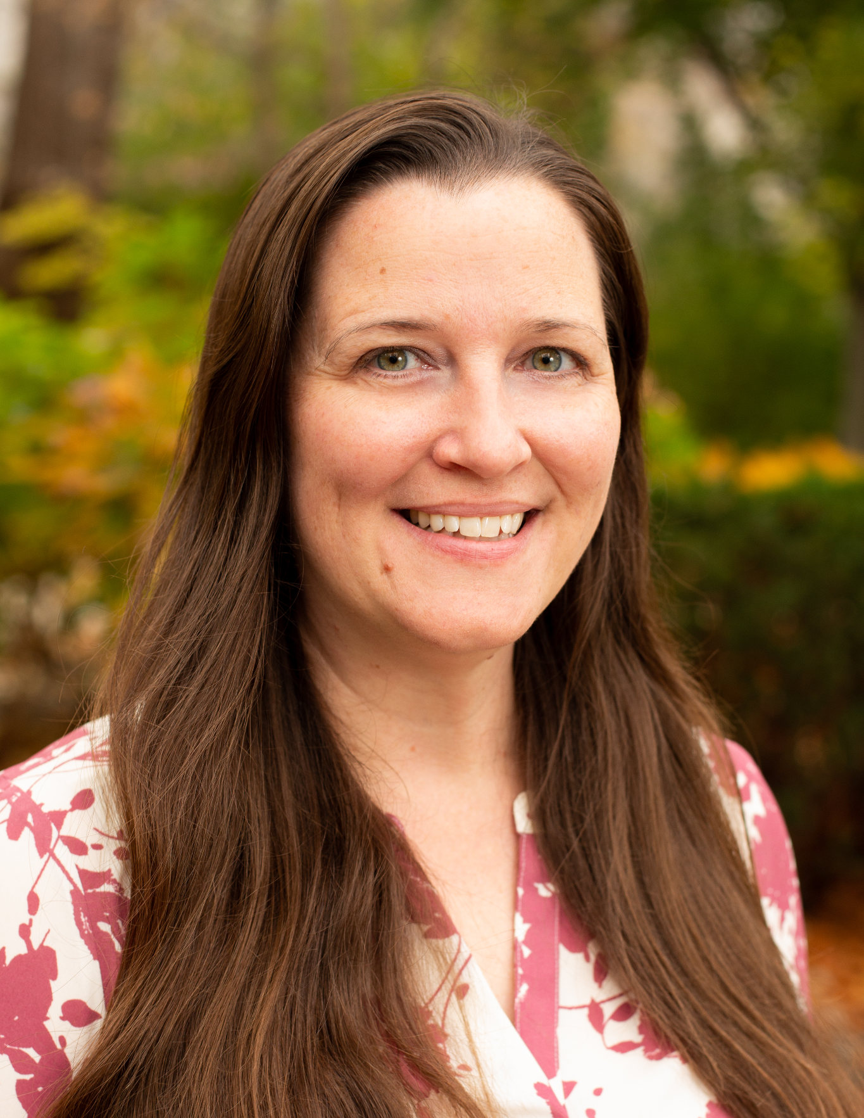
Introduction & History with Program
Rebekah Stathakis
Director of Teacher Preparation Programs
Former middle school Spanish teacher!
Notes:
Rebekah
Starting from a place of gratitude as my history begins here at NU. Grew up in Spain and Venezuela. Came to NU as an undergrad. Completed my Spanish coursework here at NU and found a home in the Spanish department. Transferred to SESP and did officially graduate through the Teaching pathway. Became a MS Spanish teacher. Came back to NU full-time in 2021. (Taught with EduNovela that was developed by NU faculty)
This program has a long history! When I was going through the program there were also German, French, and Latin teachers.

Slide 4
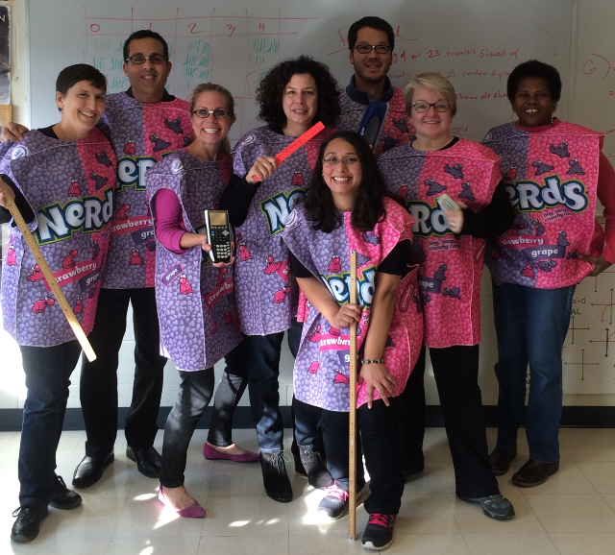
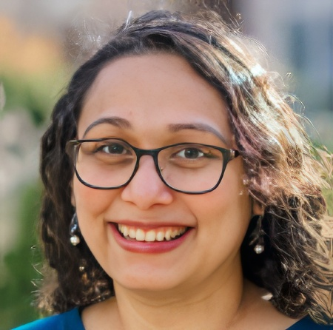
Introduction & History with Program
Gabriela Langendorf
Manager, Teacher Licensure
Former high school math teacher!
Notes:
Gaby

Slide 5

The Need for Language Educators
Notes:
Rebekah

Slide 6
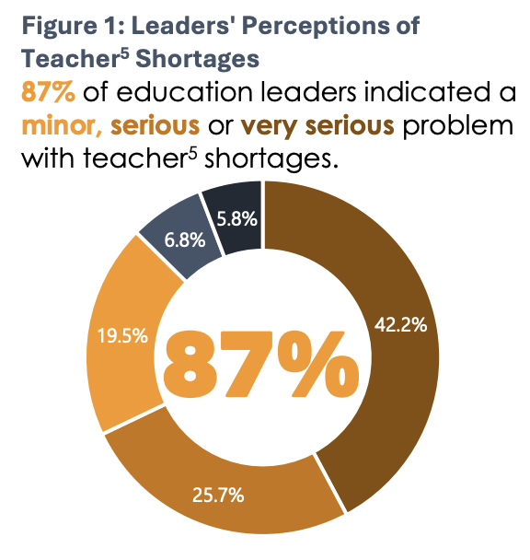
The Need for World Language Educators
World Language instruction is vital.
Illinois continues to face a shortage of language educators (world language, bilingual, and ESL)
Notes:
Rebekah
Teacher shortage is actually easing (https://www.isbe.net/Lists/News/NewsDisplay.aspx?ID=1532)
However, there are gaps in where there are needs.
https://iarss.org/wp-content/uploads/2025/03/IWERC-Educator-Shortage-SY25-250313.pdf

Slide 7
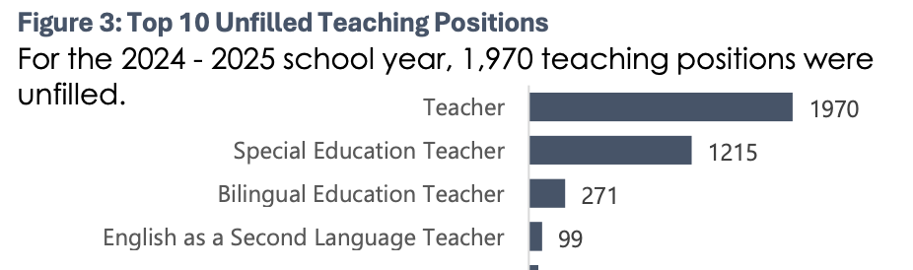
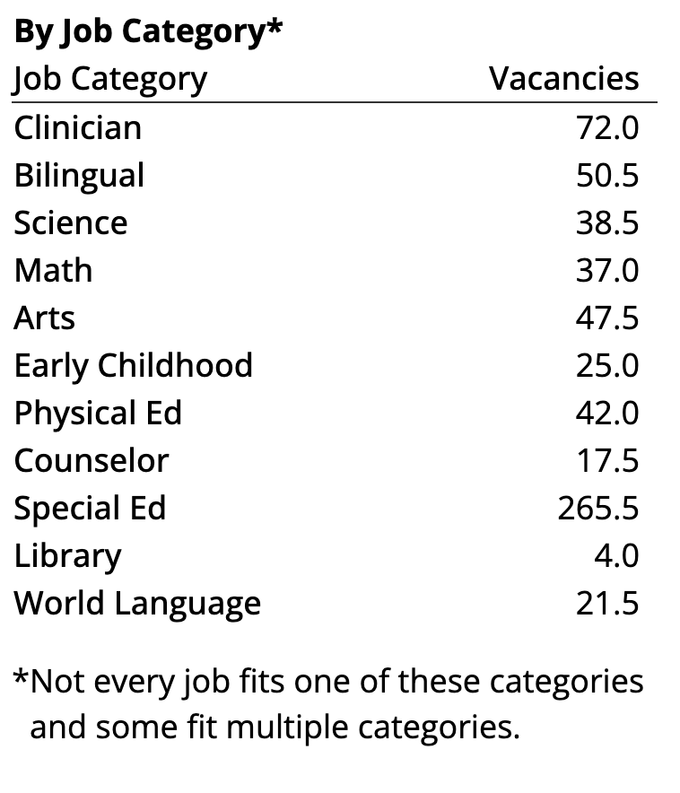
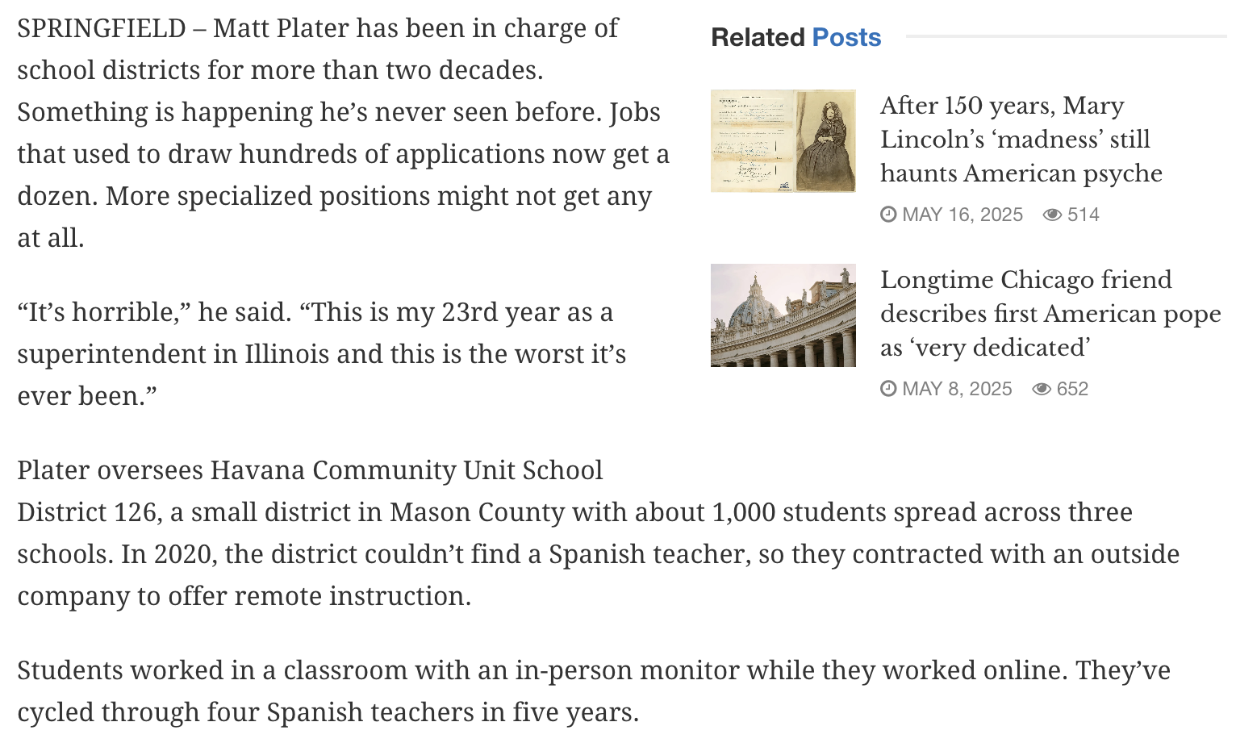
CPS Vacancies in September for the 24-25 School Year
Notes:
Rebekah

Slide 8
Pathways at
Northwestern
Notes:
Gaby

Slide 9
Pathways at Northwestern
There is a long history of a partnership between SESP and the Department of Spanish and Portuguese. The Spanish department provides the content area development and SESP offers the teacher education coursework and practicum.
We also have an interrupted history with the French department (and German).
Notes:
Gaby

Slide 10

Four Main Pathways
1. Bachelor’s of Choice (WCAS) + Teaching License
  Earn your bachelor’s degree from any of Northwestern’s schools.
  Work with our licensure manager to complete teaching licensure requirements
2. SESP BSEd with Teaching Concentration
  Earn your Bachelor of Science in Education and Social Policy degree in SESP.
  Complete the teaching concentration in PK-12 World Language Teaching
3. Bachelor’s and Accelerated MSEd
  Earn your Bachelor’s degree from any of Northwestern’s schools. While you complete your bachelor’s, complete up to 6 units of your master’s degree.
  After earning your bachelor’s, finish remaining master’s requirements. With careful planning, complete an Accelerated MSEd with as few as 9 units over three quarters.
4. Traditional MSEd
  Earn your bachelor’s degree from any of Northwestern’s schools.
  Complete your master’s degree following our traditional sequence.
  Some students proceed directly to the master’s while others take time away from NU between degrees.
1. BA/BS and
Teaching License
2. SESP BSEd and
Teaching License
3. BS and
Accelerated MSEd
4. BS and
Traditional MSEd
Notes:
Gaby
We have 4 pathways but want to highlight #1 today as it might be the most relevant. We also definitely recommend that students keep #3 in mind!!

Slide 11
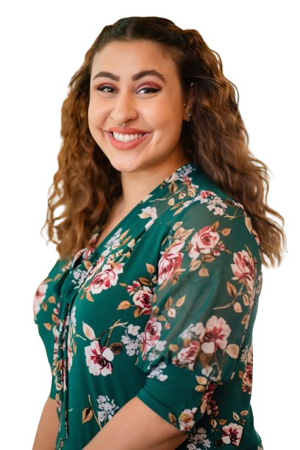
Student Spotlight: Selena
Northwestern Graduate, 2020
Spanish Teaching
Chicago Public Schools Spanish Teacher
PhD Candidate at UIC in Literacy, Language, & Culture
What was your path to classroom teaching?
I completed the Teaching program in SESP. I decided to become a teacher because I always had a passion for education, being in the classroom and helping younger kids. Everything I did was surrounding efforts to support schools and students and I knew I had to continue on that path.
Notes:
Rebekah

Slide 12
Student Spotlight: Selena
What other interests did you have at NU?
I was involved in supplies for dreams, center for talent development, and Kappa Delta Chi.
What advice do you have for prospective teachers?
The world always needs teachers; students need people who are genuine, passionate, and caring. The future of the world lies in the hands of teachers, we help to shape the minds of those who will lead the world one day. Teaching is hard at times, but it is also rewarding all of the time.
Notes:
Rebekah
What are benefits of your specific pathway into teaching? Why did you take that pathway?
The benefits of going straight through the program is the focus on education, classroom instruction, and your content area. You also get to be in a cohort of students who are pursuing like channels of education. We were able to share ideas, thoughts, content, our exams together. I keep up with members of my cohort to this day and we graduated 4 years ago. I took my pathway because I was certain education and in the classroom was where I wanted to be when I graduated and this was the quickest pathway to it.

Slide 13
Requirements
Notes:
Gaby

Slide 14
Key Requirements
Students need to enter NU with language experience.
Prior to student teaching, students need to reach Advanced-Low or higher on the OPI.
Notes:
Rebekah

Slide 15
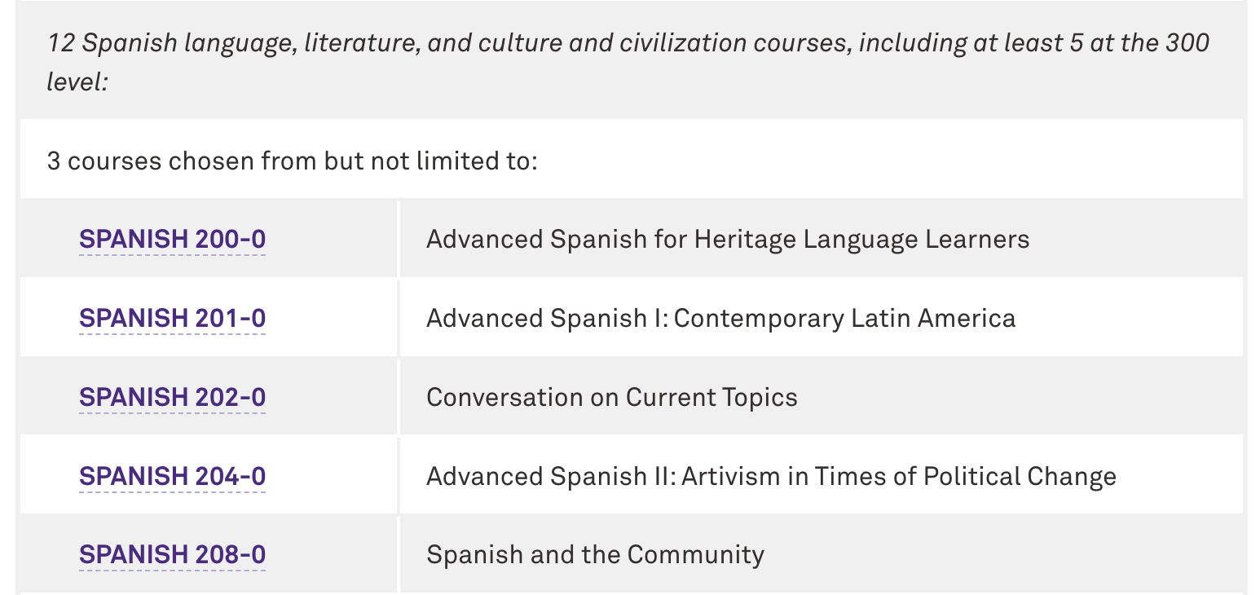
Key Requirements
Completing a major in a world language will typically include all of the content requirements for licensure.
Notes:
Gaby

Slide 16
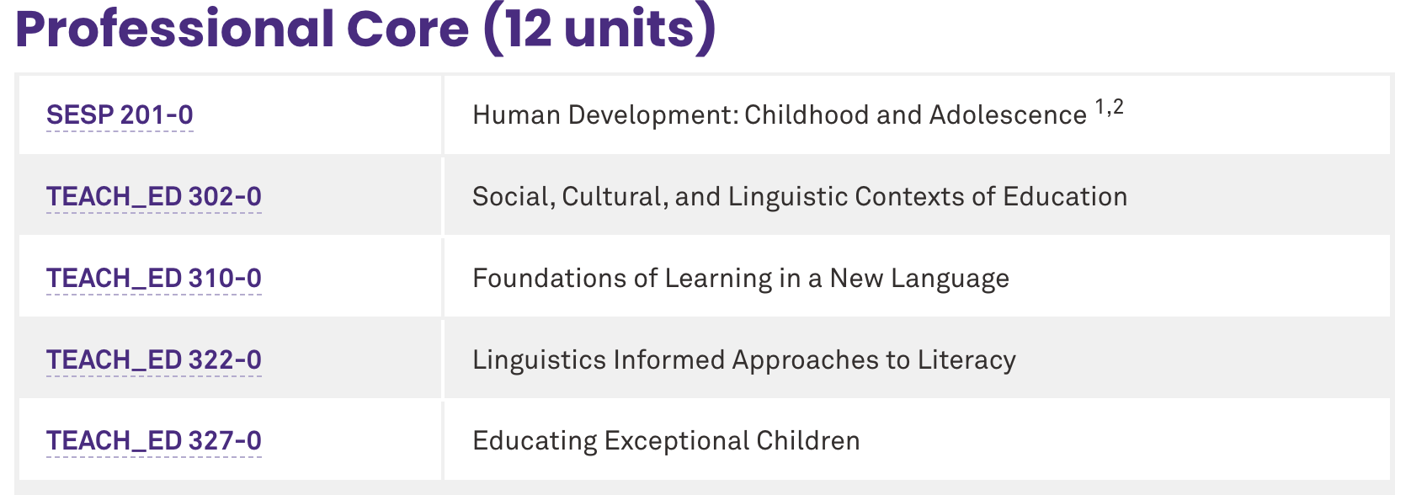
Key Requirements
Students should work with Gaby to plan out their teacher education course requirements.
Notes:
Gaby

Slide 17
Key Requirements
Students will also complete a full-time student teaching experience during their final winter quarter.
The Teaching, Learning, & Education Program in SESP manages all of the details and requirements of student teaching.
We partner with schools across the area including Chicago Public Schools, Evanston Schools, and others.
Notes:
Rebekah

Slide 18
Opportunities for the Future
Notes:
Both of us?

Slide 19
Opportunities for the Future
We would love to partner more extensively with you!
Are there opportunities to connect with students through courses, events, or other ways?
How can we better support your work or connect with you in more meaningful ways?
We are open to all ideas!
Notes:
Both?

Slide 20
Questions?
Notes:
Both

Slide 21
¡Mil Gracias!

